Slide 1
Religion & Culture in Canada
Understanding Buddhism
Slides adapted from: HarvardX: HDS3221.3x Buddhism Through Its Scriptures

Slide 2
Buddhism: an overview
Review the video and e-text on Buddhism in Blackboard
Watch the video Buddhism in brief
Reflection: What is one thing you found interesting and useful to know about Buddhism?

Slide 3
Individualism vs. Collectivism:
Summary Table
Worldview | Self-representation | Beliefs | Values
Individualism | Individual uniqueness, core essence | Belief in individual agency, responsibility, basis for achievement | Self-interest primary, pursuing personal preferences, self-actualization, freedom, independence
Collectivism | Close relationships define the self | Role responsibilities, determine behaviour, achievement requires interdependence | Responsiveness to others` needs, listening to their advice, maintaining harmony in relationships

Slide 4
Korean Buddhists in Canada
A qualitative study was conducted on ethnic Korean Buddhist young adults living in Toronto (and Ottawa) by Glen Choi. (“Lotus Pond, Bicultural Ripples: Psychological Orientations of Korean-Canadian Practitioners of Buddhism,” 2014)
There were twenty (20) participants who were interviewed face-to-face for this study.
Their breakdown in terms of gender = 11 females, 9 males.
The average age of participants was 30 years old.

Slide 5
Cultural Orientation:
Criteria
The twenty participants were then asked a series of background questions on the following topics related to cultural identification:
Ethnic self-identification: Do you self-identify as Korean? Canadian? Or Korean-Canadian?
Place(s) where participant grew up: Where were you born? Where did you grow up? How many years?
Fluency in English/Korean languages: Are you more comfortable speaking English or Korean? Or equally both?
Predominant ethnic social circle: Are your close circle of friends mostly ethnic Koreans born and raised in Canada? Or ethnic Koreans born in Korea and who came to Canada at a later age? Or non-Koreans?
Family culture: Growing up, did your parents enforce traditional Korean customs at home? And encouraged you to speak Korean? Or none of these?
Media consumption: Do you consume mostly Korean or North American media – such as TV shows, news, films etc.?

Slide 6
Korean Cultural Orientation towards Buddhism
Seven people who showed strong Korean cultural orientations in their lives (more than a Canadian cultural orientation), typically responded in the following manner:
Self-identified as Buddhist due to parents, family lineage, close relationship with local Buddhist monks growing up and fond memories of the serene temple environment growing up.
Understanding of Buddhism and Buddhist teachings derive primarily from parents and local Buddhist monks’ teachings.
Many believed in the Buddhist teachings simply because “that is what my parents/monks have told me.”
Most practiced through collective engagement at their local temple (e.g. meditating together with other adherents, listening to the Dharma Talks and individual advice of the monks, as well as the advice and experiences of the other adherents).

Slide 7
Canadian Cultural Orientation towards Buddhism
Four people who showed strong Canadian cultural orientations in their lives (more than a Korean cultural orientation), typically responded in the following manner:
Most were hesitant/reluctant to self-identify as Buddhist because “some of the teachings didn’t make sense to me.” They didn’t have the conviction or strong belief in ALL of the Buddhist teachings – only some.
*Interestingly, the Buddhist teaching that most CCO’s could not blindly accept was the teachings about future lives (or past ones), since there was no empirical scientific evidence that showed past lives exist.
Understanding of Buddhism comes primarily from own research (online, books, university courses) as well as a “piecing together” of what was taught by local Buddhist teachers, in order to find “what works for me.”

Slide 8
Canadian Cultural Orientation towards Buddhism
All practiced Buddhism and a ‘mix’ of other religions, such as Hinduism or native spirituality.
Experimented with varieties of Buddhist traditions (Mahayana AND Theravada, for example).
*Most traditional Buddhists (in Asia) stay within one of the three traditions.
Often practiced meditation at home alone.

Slide 9
I-C Theory & Korean-Canadian Buddhist Young Adults
Did you notice a pattern in this study?
Participants who showed a stronger Korean cultural orientation showed a stronger collectivistic approach and attitude toward Buddhism.
Participants who showed a stronger Canadian cultural orientation showed a stronger individualistic approach and attitude toward Buddhism.
Participants who showed equally Korean and Canadian cultural orientations showed (for the most part) equally collectivistic and individualistic approaches and attitudes toward Buddhism.
Critical thinking: Other factors that might influence pattern are age, gender, type of Buddhism, few study participants

Slide 10
Highlighting the diversity iu Buddhism
Watch video Multiple voices
As you watch: what types of diversity are reflected in the video?
Notes:
https://www.youtube.com/watch?v=Dd09y2Is0-4

Slide 11
Buddhism & Democracy
Buddhists today come to scripture with modern concerns such as the value of democracy and human rights
Quote form Dalai Lama
  “Although none of our Buddhist societies developed anything like democracy in their systems of government, I personally have great admiration for secular democracy.”
Read the Theravadan version of the 5 precepts
Compare with Thich Nhat Hanh’s 5 mindfulness teachings
  Example of scriptures evolving over time
Reflection: For any sacred text, would you prefer to hear the original sacred text or an updated version of the sacred text? Explain your answer.
Notes:
http://www.dalailama.com/messages/buddhism/buddhism-and-democracy

Slide 12
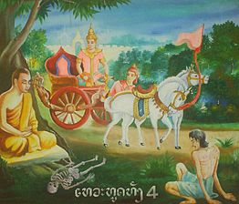
Scriptures and transformation
Buddhist practice now circulate in the world quite independently of anything Buddhist at all
Watch this video on Mindfulness Based Stress Reduction
Reflection: This practice historically has been in the context of religious beliefs and ethics codes. What are the pros and cons of this kind of cultural appropriation?
Notes:
https://www.youtube.com/watch?time_continue=178&v=PvHkI-uART4

Slide 13
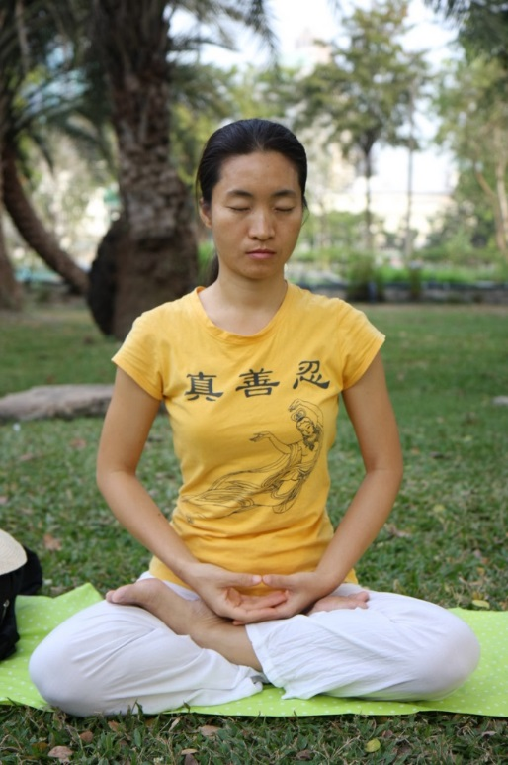
Buddhism and women
Therigatha: collection of poems from early nuns
  Canda the beggar
Reflection: What information is revealed about the lives of these women?

Slide 14
Women in scripture
The discourse on loving kindness
Mother’s concern for child as metaphor for compassion
Reflection: Why does motherhood play such a powerful role in Buddhist and other scriptures?

Slide 15
Women & ordination
Buddha ordained women, but they lived by more rules (327) than monks (211)
Nuns common in some parts of Asia such as Taiwan
  Controversial in SE Asia (Thailand & Sri Lanka)
Highlight theme of intolerance to new ways of understanding

Slide 16
Buddhism & science
Modern science influences how Buddhist scriptures are interpreted
"If science proves some belief of Buddhism wrong, then Buddhism will have to change. In my view, science and Buddhism share a search for the truth and for understanding reality. By learning from science about aspects of reality where its understanding may be more advanced, I believe that Buddhism enriches its own worldview.“
(From, Our faith in science by the Dalai Lama)

